Slide 1
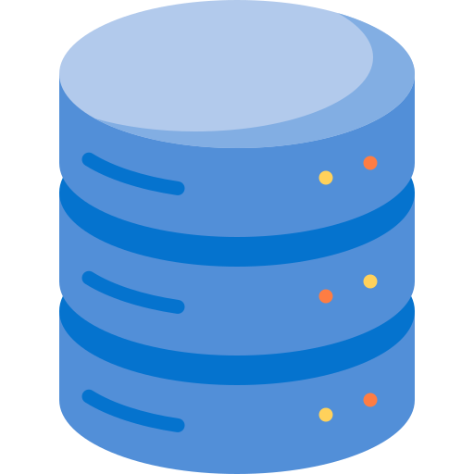

What's SQL and what’s used for?
SQL is the acronym of Structured Query Language.
It's a programming language used for managing data kept in a RDBMS (Relational DataBase Management System).
Despite being an ANSI and ISO standard, each RDBMS has its own extension, Oracle has PL/SQL, PostgreSQL has PL/pgSQL, Microsoft has T-SQL, and so on.

Slide 2
Types of SQL commands
DDL
Data Definition Language
It's used for create and modify the DB structure and its objects.
Commands are CREATE, DROP, ALTER, TRUNCATE and RENAME
DML
Data Manipulation Language
It's used inserting, updating and deleting data in a DB, so we have INSERT, UPDATE and DELETE
DCL
Data Control Language
It's used for access the stored data.
Commands are GRANT and REVOKE
TCL
Transaction Control Language
It's used for handling the transaction, its commands are COMMIT and ROLLBACK

Slide 3

Credits & Let’s connect
Database icons created by Freepik - Flaticon
Logo created by MyFreeLogoMaker
Linkedin icons created by riajulislam - Flaticon
If you want to learn more about the topic, connect or send me a DM.
Manuel Gentile

